Slide 1
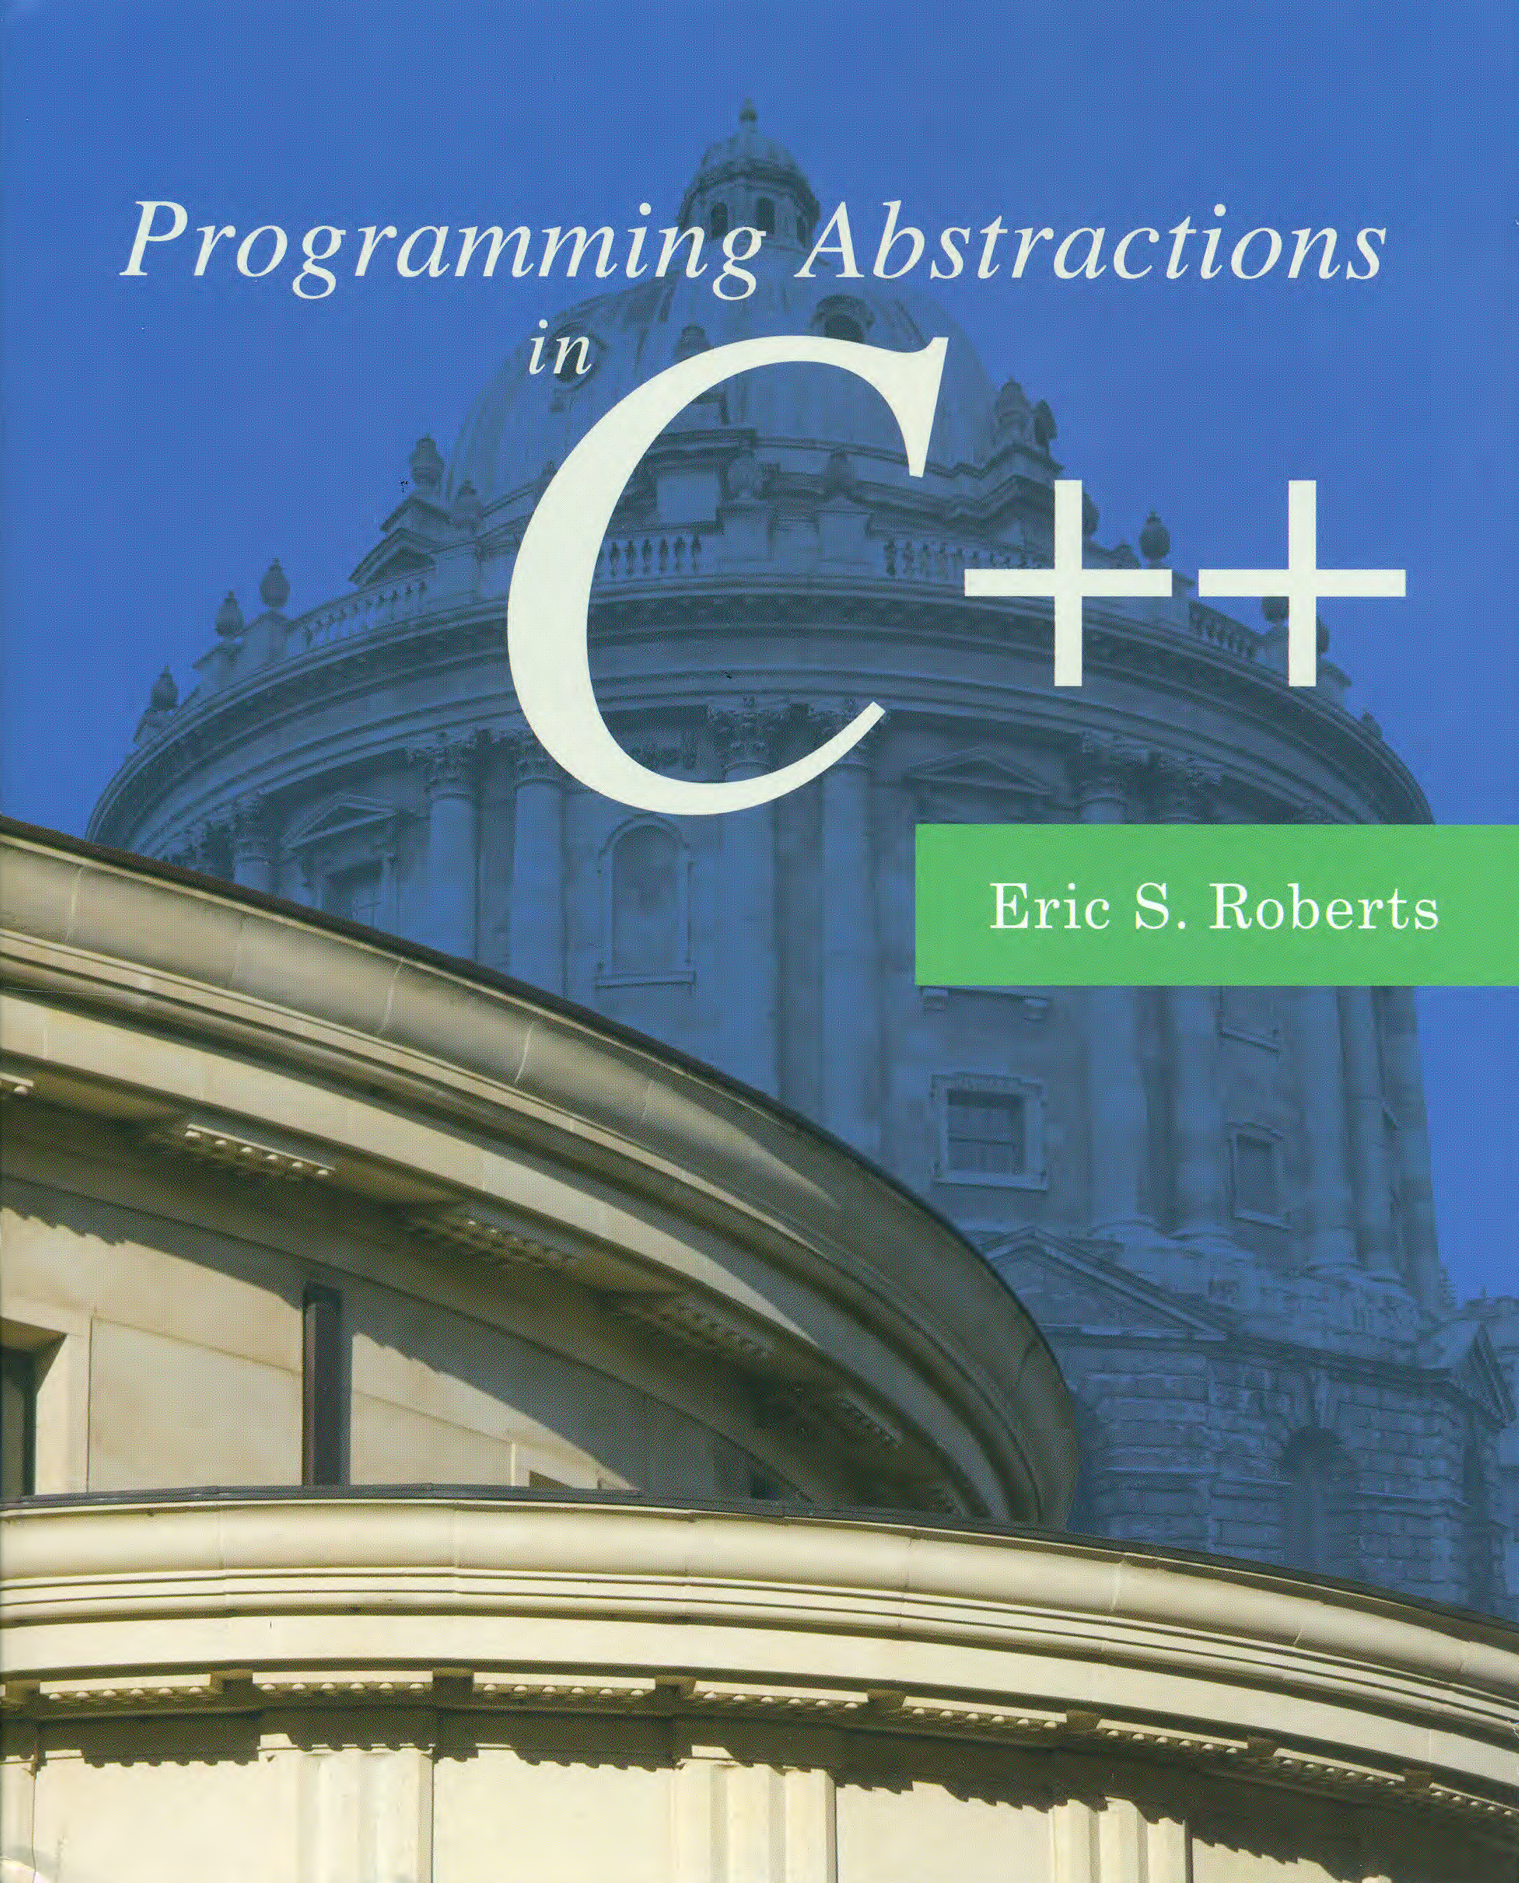
Introduction to Recursion
C H A P T E R 7
And often enough, our faith beforehand in a certain result is the only thing that makes the result come true.
—William James, The Will to Believe, 1897
7.1 A simple example of recursion
7.2 The factorial function
7.3 The Fibonacci function
7.4 Checking palindromes
7.5 The binary search algorithm
7.6 Mutual recursion
7.7 Thinking recursively

Slide 2
Recursion
One of the most important “Great Ideas” in programming is the concept of recursion, which is the process of solving a problem by dividing it into smaller sub-problems of the same form. The emphasized phrase is the essential characteristic of recursion; without it, all you have is a description of top-down design/stepwise refinement we have studied earlier. It is a special kind of divide and conquer.
The fact that recursive decomposition generates sub-problems that have the same form as the original problem means that recursive programs will use the same function or method to solve sub-problems at different levels of the solution. In terms of the structure of the code, the defining characteristic of recursion is having functions that call themselves, directly or indirectly, as the decomposition process proceeds.

Slide 3
A Simple Illustration of Recursion
Suppose that you are the national fundraising director for a charitable organization and need to raise $1,000,000.
One possible approach is to find a wealthy donor and ask for a single $1,000,000 contribution. The problem with that strategy is that individuals with the necessary combination of means and generosity are difficult to find. Donors are much more likely to make contributions in the $100 range.
Another strategy would be to ask 10,000 friends for $100 each. Unfortunately, most of us don’t have 10,000 friends.
There are, however, more promising strategies. You could, for example, find ten regional coordinators and charge each one with raising $100,000. Those regional coordinators could in turn delegate the task to local coordinators, each with a goal of $10,000, continuing the process reached a manageable contribution level.

Slide 4
A Simple Illustration of Recursion
The following diagram illustrates the recursive strategy for raising $1,000,000 described on the previous slide:
Goal:
$1,000,000
Goal:
$100,000
Goal:
$100,000
Goal:
$100,000
Goal:
$100,000
Goal:
$100,000
Goal:
$100,000
Goal:
$100,000
Goal:
$100,000
Goal:
$100,000
Goal:
$100,000
Goal:
$10,000
Goal:
$10,000
Goal:
$10,000
Goal:
$10,000
Goal:
$10,000
Goal:
$10,000
Goal:
$10,000
Goal:
$10,000
Goal:
$10,000
Goal:
$10,000
Goal:
$1000
Goal:
$1000
Goal:
$1000
Goal:
$1000
Goal:
$1000
Goal:
$1000
Goal:
$1000
Goal:
$1000
Goal:
$1000
Goal:
$1000
Goal:
$100
Goal:
$100
Goal:
$100
Goal:
$100
Goal:
$100
Goal:
$100
Goal:
$100
Goal:
$100
Goal:
$100
Goal:
$100

Slide 5
A Pseudocode Fundraising Strategy
If you were to implement the fundraising strategy in the form of a C++ function, it would look something like this:
what makes this strategy recursive is that the line:
will be implemented using the following recursive call:
void collectContributions(int n) {
if (n <= 100) {
Collect the money from a single donor.
} else {
Find 10 volunteers.
Get each volunteer to collect n/10 dollars.
Combine the money raised by the volunteers.
}
}
Get each volunteer to collect n/10 dollars.
collectContributions(n/10);

Slide 6
The Recursive Paradigm
Most recursive methods you encounter in an introductory course have bodies that fit the following general pattern:
Finding a recursive solution is mostly a matter of figuring out how to break it down so that it fits the paradigm. When you do so, you must do two things:
Identify simple cases that can be solved without recursion.
Find a recursive decomposition that breaks each instance of the problem into simpler sub-problems of the same type, which you can then solve by applying the method recursively.
if (test for a simple case) {
Compute and return the simple solution without using recursion.
} else {
Divide the problem into one or more sub-problems that have the same form.
Solve each of the sub-problems by calling this method recursively.
Return the solution by reassembling the results of the various sub-problems.
}

Slide 7
Recursive Functions
The easiest examples of recursion to understand are functions in which the recursion is clear from the definition. As an example, consider the factorial function, which can be defined in either of the following ways:
The two definitions lead directly to different implementations, one iteration-based and the other recursion-based:
n! = n ^{x} (n − 1) ^{x} (n − 2) ^{x} . . . ^{x} 3 ^{x} 2 ^{x} 1
1
if n is 0
n! =
n ^{x} (n − 1)!
otherwise
int fact(int n) {
int result = 1;
for (int i = 1; i <= n; i++) {
result *= i;
}
return result;
}
int fact(int n) {
if (n == 0) {
return 1;
} else {
return n * fact(n - 1);
}
}

Slide 8
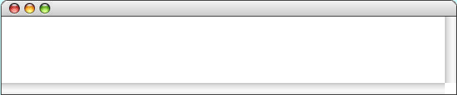
Simulating the fact Function
int main() {
cout << "Enter n: ";
int n = getInteger();
cout << n << "! = " << fact(n) << endl;
return 0;
}
int fact(int n) {
if (n == 0) {
return 1;
} else {
return n * fact(n - 1);
}
}
int fact(int n) {
if (n == 0) {
return 1;
} else {
return n * fact(n - 1);
}
}
n
int fact(int n) {
if (n == 0) {
return 1;
} else {
return n * fact(n - 1);
}
}
120
5
int fact(int n) {
if (n == 0) {
return 1;
} else {
return n * fact(n - 1);
}
}
n
int fact(int n) {
if (n == 0) {
return 1;
} else {
return n * fact(n - 1);
}
}
5
24
n
int fact(int n) {
if (n == 0) {
return 1;
} else {
return n * fact(n - 1);
}
}
4
int fact(int n) {
if (n == 0) {
return 1;
} else {
return n * fact(n - 1);
}
}
6
n
3
2
n
2
1
n
1
n
1
n
0
0
RecursiveFactorial
Enter n:
5
5! = 120
skip simulation

Slide 9

The Recursive “Leap of Faith”
The purpose of going through the complete decomposition of the factorial function is to convince you that the process works and that recursive calls are in fact no different from other method calls, at least in their internal operation.
The danger with going through these details is that it might encourage you to do the same when you write your own recursive programs. As it happens, tracing through the details of a recursive program almost always makes such programs harder to write. Writing recursive programs becomes natural only after you have enough confidence in the process that you don’t need to trace them fully.
As you write a recursive program, it is important to believe that any recursive call will return the correct answer as long as the arguments define a simpler sub-problem. Believing that to be true, even before you have completed the code, is called the recursive leap of faith.

Slide 10
Mathematical Induction
Algorithmic analysis often requires proving properties that apply to all nonnegative integers. For example, the analysis of selection sort depended on the correctness of the following formula:
The most important mathematical technique for proving the correctness of such formulas is mathematical induction, which consists of the following steps:
Prove the base case. In the base case, you prove that the formula holds when N has the basis value, which is typically 0 or 1.
Prove the inductive case. The second step is to show that assuming the formula holds for N, you can prove that it holds for N + 1.
N
N ^{x} (N + 1)
∑
1 + 2 + 3 + . . . + (N - 1) + N =
i
=
2
i = 1

Slide 11
Example of Mathematical Induction
To prove:
Base case:
Inductive case:
N ^{x} (N + 1)
1 + 2 + 3 + . . . + (N - 1) + N =
2
0 ^{x} (0 + 1)
0 =
2
1 + 2 + 3 + . . . + (N - 1) + N + (N + 1)
N ^{x} (N + 1)
=
+ (N + 1)
2
N ^{x} (N + 1)
(2N + 2)
=
+
2
2
N ² + 3N + 2
=
2
(N + 1) ^{x} (N + 2)
=
2

Slide 12
Recursion vs. Induction
Both induction and recursion require you to make a leap of faith.
When you write a recursive function, this leap consists of believing that all simpler instances of the function call will work without your paying any attention to the details.
Making the inductive hypothesis requires much the same mental discipline.
In both cases, you have to restrict your thinking to one level of the solution and not get sidetracked trying to follow the details all the way to the end.

Slide 13
The Fibonacci Function
In 1202, the Italian mathematician Leonardo Fibonacci published a treatise entitled Liber Abaci in which he argued for the adoption of the Hindu-Arabic numbering system over the far more cumbersome system of Roman numerals still in use at the time.
As one of the examples in Liber Abaci, Fibonacci asked a question about the growth pattern in a population of rabbits under the following, admittedly fanciful assumptions:
Rabbit pairs become fertile two months after their birth.
Fertile rabbit pairs produce a new pair every month.
Old rabbits never die but keep on reproducing.
The sequence of values recording the population of rabbits turns up in a surprising number of contexts and is called the Fibonacci sequence.

Slide 14


Fibonacci’s Rabbits
Jan
1
Feb
1
Mar
2
Apr
3
May
5
Jun
8
Jul
13

Slide 15
Recursive Formulation of fib(n)
The n^{th} term in the Fibonacci sequence has the following recursive definition:
As with factorial, the recursive definition leads directly to an implementation, as follows:
Is this a good program?
Extremely inefficient! Why?
n
if n is 0 or 1
fib(n) =
otherwise
fib(n – 1) + fib(n – 2)
int fib(int n) {
if (n < 2) {
return n;
} else {
return fib(n – 1) + fib(n - 2);
}
}

Slide 16
Recursive Formulation of fib(n)

Slide 17
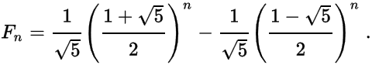
Improve fib(n)
Use the analytical form?
Use iterations?
Use another form of recursion?
int fib(int n) {
if (n == 0) return 0;
if (n == 1) return 1;
int f0 = 0, f1 = 1, f2 = 1;
for (int i = 3; i <= n; i++) {
f0 = f1, f1 = f2, f2 = f0 + f1;
}
return f2;
}
int fib(int n) {
return additiveSequence(n, 0, 1);
}
int additiveSequence(int n, int t0, int t1) {
if (n == 0) return t0;
if (n == 1) return t1;
return additiveSequence(n - 1, t1, t0 + t1);
}
fib(5)
= additiveSequence(5,0,1)
= additiveSequence(4,1,1)
= additiveSequence(3,1,2)
= additiveSequence(2,2,3)
= additiveSequence(1,3,5)
= 5

Slide 18
Exercise: Greatest Common Divisor
Remember the Euclid’s algorithm for computing the Greatest Common Divisor (GCD) of two integers, x and y? Euclid’s algorithm is usually implemented iteratively using code that looks like this:
int gcd(int x, int y) {
int r = x % y;
while (r != 0) {
x = y;
y = r;
r = x % y;
}
return y;
}

Slide 19
Solution: A Recursive GCD Function
Rewrite this method so that it uses recursion instead of iteration, taking advantage of Euclid’s insight that the greatest common divisor of x and y is also the greatest common divisor of y and the remainder of x divided by y, which shows the recursive nature of the problem.
As is usually the case, the key to solving this problem is finding the recursive decomposition and defining appropriate simple cases.
int gcd(int x, int y) {
if (x % y == 0) {
return y;
} else {
return gcd(y, x % y);
}
}

Slide 20
Palindromes
Recursion is not limited to numeric examples and appears naturally in many other contexts. For example, we have written a program to check whether a string is a palindrome (e.g., “level”, “noon”, in Ch. 3), which can also be recognized recursively if one of the two following cases applies:
It is empty or contains a single character.
Its first and last characters match and enclose a palindrome.
This decomposition gives rise to the following code:
bool isPalindrome(string str) {
int len = str.length();
if (len <= 1) {
return true;
} else {
return str[0] == str[len – 1] &&
isPalindrome(str.substr(1, len – 2));
}
}

Slide 21
Palindromes
You can improve the performance of isPalindrome by making the following changes:
Calculate the length of the argument only once.
Don’t make a substring on each call (although it is shorter).
The improved code:
bool isSubstringPalindrome(string & str, int p1, int p2) {
if (p1 >= p2) {
return true;
} else {
return str[p1] == str[p2] &&
isSubstringPalindrome(str, p1 + 1, p2 - 1);
}
}
bool isPalindrome(string str) {
return isSubstringPalindrome(str, 0, str.length() - 1);
}

Slide 22
Linear Search
The simplest strategy for searching is to start at the beginning of the array and look at each element in turn. This algorithm is called linear search.
Linear search is straightforward to implement, as illustrated in the following method that returns the first index at which the value key appears in array, or -1 if it does not appear at all:
int linearSearch(int key, Vector<int> array) {
for (int i = 0; i < array.size(); i++) {
if (key == array[i]) return i;
}
return -1;
}

Slide 23
Searching for Area Codes
To illustrate the efficiency of linear search, it is useful to work with a somewhat larger example.
The example on the next slide works with an array containing many of the area codes assigned to the United States.
The specific task in this example is to search this list to find the area code for the Silicon Valley area, which is 650.
The linear search algorithm needs to examine each element in the array to find the matching value. As the array gets larger, the number of steps required for linear search grows in the same proportion.
As you watch the slow process of searching for 650 on the next slide, try to think of a more efficient way in which you might search this particular array for a given area code.

Slide 24
Linear Search (Area Code Example)
201
202
203
205
206
207
208
209
210
212
213
214
215
216
217
218
219
224
225
228
229
231
0
1
2
3
4
5
6
7
8
9
10
11
12
13
14
15
16
17
18
19
20
21
234
239
240
248
251
252
253
254
256
260
262
267
269
270
276
281
283
301
302
303
304
305
22
23
24
25
26
27
28
29
30
31
32
33
34
35
36
37
38
39
40
41
42
43
307
308
309
310
312
313
314
315
316
317
318
319
320
321
323
325
330
331
334
336
337
339
44
45
46
47
48
49
50
51
52
53
54
55
56
57
58
59
60
61
62
63
64
65
347
351
352
360
361
364
385
386
401
402
404
405
406
407
408
409
410
412
413
414
415
416
66
67
68
69
70
71
72
73
74
75
76
77
78
79
80
81
82
83
84
85
86
87
417
419
423
424
425
430
432
434
435
440
443
445
469
470
475
478
479
480
484
501
502
503
88
89
90
91
92
93
94
95
96
97
98
99
100
101
102
103
104
105
106
107
108
109
504
505
507
508
509
510
512
513
515
516
517
518
520
530
540
541
551
559
561
562
563
564
110
111
112
113
114
115
116
117
118
119
120
121
122
123
124
125
126
127
128
129
130
131
567
570
571
573
574
575
580
585
586
601
602
603
605
606
607
608
609
610
612
614
615
616
132
133
134
135
136
137
138
139
140
141
142
143
144
145
146
147
148
149
150
151
152
153
617
618
619
620
623
626
630
631
636
641
646
650
651
660
661
662
678
682
701
702
703
704
154
155
156
157
158
159
160
161
162
163
164
165
166
167
168
169
170
171
172
173
174
175
706
707
708
712
713
714
715
716
717
718
719
720
724
727
731
732
734
740
754
757
760
762
176
177
178
179
180
181
182
183
184
185
186
187
188
189
190
191
192
193
194
195
196
197
763
765
769
770
772
773
774
775
779
781
785
786
801
802
803
804
805
806
808
810
812
813
198
199
200
201
202
203
204
205
206
207
208
209
210
211
212
213
214
215
216
217
218
219
814
815
816
817
818
828
830
831
832
835
843
845
847
848
850
856
857
858
859
860
862
863
220
221
222
223
224
225
226
227
228
229
230
231
232
233
234
235
236
237
238
239
240
241
864
865
870
878
901
903
904
906
907
908
909
910
912
913
914
915
916
917
918
919
920
925
242
243
244
245
246
247
248
249
250
251
252
253
254
255
256
257
258
259
260
261
262
263
928
931
936
937
940
941
947
949
951
952
954
956
959
970
971
972
973
978
979
980
985
989
264
265
266
267
268
269
270
271
272
273
274
275
276
277
278
279
280
281
282
283
284
285

Slide 25
The Idea of Binary Search
The fact that the area code array is in ascending order makes it possible to find a particular value much more efficiently.
The key insight is that you get more information by starting at the middle element than you do by starting at the beginning.
When you look at the middle element in relation to the value you’re searching for, there are three possibilities:
If the value you are searching for is greater than the middle element, you can discount every element in the first half of the array.
If the value you are searching for is less than the middle element, you can discount every element in the second half of the array.
If the value you are searching for is equal to the middle element, you can stop because you’ve found the value you’re looking for.
You can repeat this process on the elements that remain after each cycle. Because this algorithm proceeds by dividing the list in half each time, it is called binary search.

Slide 26
Binary Search (Area Code Example)
143 + 177
143 + 213
143 + 285
161 + 177
161 + 168
165 + 165
0 + 285
165 + 168
, which is the 650 at index 165:
Continue with element
, which is the 630 at index 160:
Continue with element
, which is the 708 at index 178:
Binary search needs to look at only eight elements to find 650.
The key 650 is greater than 602, so discard the first half.
Continue with element
The key 650 is less than 805, so discard the second half.
The key 650 is less than 708, so discard the second half.
The key 650 is greater than 630, so discard the first half.
Continue with element
The key 650 is less than 662, so discard the second half.
Continue with element
The key 650 is greater than 646, so discard the first half.
The key 650 is less than 651, so discard the second half.
The key 650 is equal to 650, so the process is finished.
, which is the 805 at index 214:
, which is the 662 at index 169:
, which is the 646 at index 164:
Start with the element at index
Continue with element
, which is the 602 at index 142:
Continue with element
, which is the 651 at index 166:
2
2
2
2
2
2
2
2
201
202
203
205
206
207
208
209
210
212
213
214
215
216
217
218
219
224
225
228
229
231
0
1
2
3
4
5
6
7
8
9
10
11
12
13
14
15
16
17
18
19
20
21
234
239
240
248
251
252
253
254
256
260
262
267
269
270
276
281
283
301
302
303
304
305
22
23
24
25
26
27
28
29
30
31
32
33
34
35
36
37
38
39
40
41
42
43
307
308
309
310
312
313
314
315
316
317
318
319
320
321
323
325
330
331
334
336
337
339
44
45
46
47
48
49
50
51
52
53
54
55
56
57
58
59
60
61
62
63
64
65
347
351
352
360
361
364
385
386
401
402
404
405
406
407
408
409
410
412
413
414
415
416
66
67
68
69
70
71
72
73
74
75
76
77
78
79
80
81
82
83
84
85
86
87
417
419
423
424
425
430
432
434
435
440
443
445
469
470
475
478
479
480
484
501
502
503
88
89
90
91
92
93
94
95
96
97
98
99
100
101
102
103
104
105
106
107
108
109
504
505
507
508
509
510
512
513
515
516
517
518
520
530
540
541
551
559
561
562
563
564
110
111
112
113
114
115
116
117
118
119
120
121
122
123
124
125
126
127
128
129
130
131
567
570
571
573
574
575
580
585
586
601
602
603
605
606
607
608
609
610
612
614
615
616
132
133
134
135
136
137
138
139
140
141
142
143
144
145
146
147
148
149
150
151
152
153
617
618
619
620
623
626
630
631
636
641
646
650
651
660
661
662
678
682
701
702
703
704
154
155
156
157
158
159
160
161
162
163
164
165
166
167
168
169
170
171
172
173
174
175
706
707
708
712
713
714
715
716
717
718
719
720
724
727
731
732
734
740
754
757
760
762
176
177
178
179
180
181
182
183
184
185
186
187
188
189
190
191
192
193
194
195
196
197
763
765
769
770
772
773
774
775
779
781
785
786
801
802
803
804
805
806
808
810
812
813
198
199
200
201
202
203
204
205
206
207
208
209
210
211
212
213
214
215
216
217
218
219
814
815
816
817
818
828
830
831
832
835
843
845
847
848
850
856
857
858
859
860
862
863
220
221
222
223
224
225
226
227
228
229
230
231
232
233
234
235
236
237
238
239
240
241
864
865
870
878
901
903
904
906
907
908
909
910
912
913
914
915
916
917
918
919
920
925
242
243
244
245
246
247
248
249
250
251
252
253
254
255
256
257
258
259
260
261
262
263
928
931
936
937
940
941
947
949
951
952
954
956
959
970
971
972
973
978
979
980
985
989
264
265
266
267
268
269
270
271
272
273
274
275
276
277
278
279
280
281
282
283
284
285

Slide 27
Binary Search
/*
* Function: binarySearch
* Usage: int index = binarySearch(key, vec, p1, p2);
* --------------------------------------------------
* Searches for the specified key in the Vector<string> vec, looking
* only at indices between p1 and p2, inclusive. The function returns
* the index of a matching element, or -1 if no match is found.
*/
int binarySearch(string key, Vector<string> & vec, int p1, int p2) {
if (p1 > p2) return -1;
int mid = (p1 + p2) / 2;
if (key == vec[mid]) return mid;
if (key < vec[mid]) {
return binarySearch(key, vec, p1, mid - 1);
} else {
return binarySearch(key, vec, mid + 1, p2);
}
}

Slide 28
Mutual Recursion
In some cases, recursive processes involve more than a single function. Instead, one function calls another, which calls another, which eventually circles back around to the original function. Such situations are called mutual recursion.
The text uses the following simple example to illustrate mutual recursion, although it is inefficient!
bool isOdd(unsigned int n) {
return !isEven(n);
}
bool isEven(unsigned int n) {
if (n == 0) {
return true;
} else {
return isOdd(n – 1);
}
}

Slide 29
Thinking Recursively
Writing recursive programs requires developing a new way of thinking about problems that focuses more on a holistic view of the problem than on the details by adopting the recursive leap of faith.
The following checklist may prove helpful:
Does your implementation begin by checking for simple cases?
Have you solved the simple cases correctly?
Does your recursive decomposition make the problem simpler?
Does the simplification eventually reach the simple cases?
Do the recursive calls in your function represent sub-problems that are truly identical in form to the original?
Do the solutions to the recursive sub-problems provide a complete solution to the original problem?
Avoid nonterminating recursion, the recursive analogue of the infinite loop.

Slide 30

Thinking Recursively
bool isOdd(unsigned int n) {
return !isEven(n);
}
bool isEven(unsigned int n) {
return !isOdd(n);
}
bool isOdd(unsigned int n) {
return isEven(n-1);
}
bool isEven(unsigned int n) {
return isOdd(n-1);
}
bool isOdd(unsigned int n) {
return !isEven(n);
}
bool isEven(unsigned int n) {
if (n == 0) return true;
return isOdd(n-1);
}
bool isOdd(unsigned int n) {
return !isEven(n);
}
bool isEven(unsigned int n) {
if (n == 0) return true;
return !isEven(n-1);
}

Slide 31
Thinking Recursively
bool isOdd(unsigned int n) {
return !isEven(n);
}
bool isEven(unsigned int n) {
if (n == 0) return true;
return isEven(n-2);
}
bool isOdd(unsigned int n) {
return !isEven(n);
}
bool isEven(unsigned int n) {
if (n == 0) return true;
if (n == 1) return false;
return isEven(n-2);
}
bool isOdd(unsigned int n) {
if (n == 1) return true;
return isEven(n-1);
}
bool isEven(unsigned int n) {
if (n == 0) return true;
return isOdd(n-1);
}
bool isOdd(unsigned int n) {
if (n == 0) return false;
return isEven(n-1);
}
bool isEven(unsigned int n) {
if (n == 0) return true;
return isOdd(n-1);
}

Slide 32
The End

